Slide 1
CAS610MJ: Cloud API's and Services

Slide 2
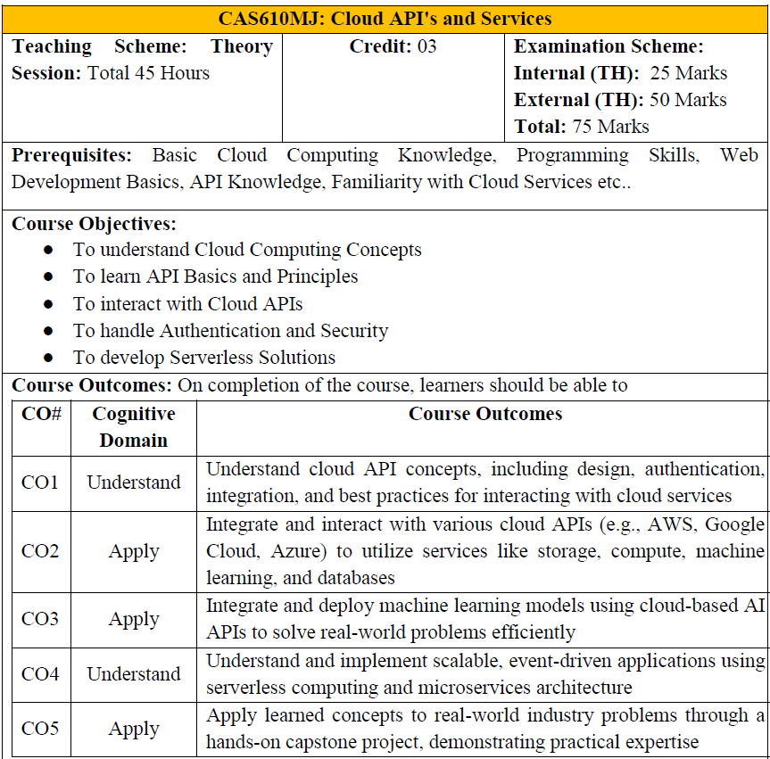

Slide 3
Contents
Fundamentals of Cloud APIs [20]
Cloud APIs and Integration [20]
Cloud AI & Machine Learning APIs [20]
Serverless Computing & Microservices [20]
Capstone Project & Industry Use Cases [20]
1
2
3
4
5

Slide 4
Fundamentals of Cloud APIs

Slide 5
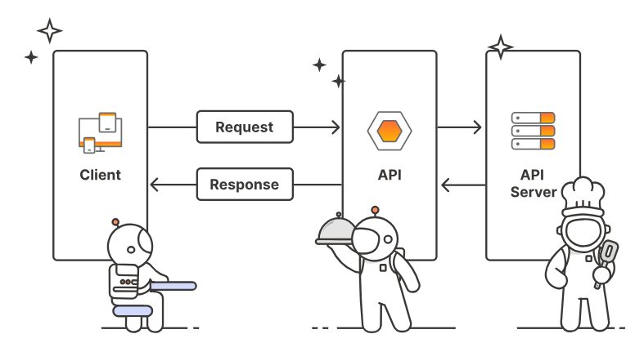
What is an API?
API (Application Programming Interface) allows software components to interact.
It is a set of rules and specifications that allows different software systems to communicate and interact with each other.
It acts as a middleman, enabling one application to request and receive data or functionality from another, without needing to know the internal workings of the other application.
it as a contract between two software components — one provides a service, and the other consumes it.
APIs abstract the complex internal logic and expose only necessary functions (endpoints) to the user.

Slide 6
What is an API?
Example:
A weather app uses an API to fetch data from a weather service — it doesn’t need to know how that service calculates weather, only how to request and receive it.
https://api.openweathermap.org/data/3.0/onecall?lat=33.44&lon=-94.04&exclude=hourly,daily&appid={API key}
Refer - https://openweathermap.org/api/one-call-3#how
Benefits:
Simplified development: Developers can reuse existing functionalities through APIs, saving time and effort.
Increased flexibility: APIs enable applications to be more flexible and adaptable to changes in technology.
Enhanced interoperability: APIs facilitate communication and integration between different systems, regardless of their underlying technology.

Slide 7
On-Premises V/s Cloud
Feature | On-Premises | Cloud Computing
Infrastructure Location | Located and managed on-site (local data center) | Hosted by third-party cloud provider (remote)
Ownership | Fully owned and maintained by the organization | Rented or pay-as-you-go model
Cost Model | High upfront CapEx (hardware, setup) | Low upfront cost; OpEx-based (subscription)
Scalability | Limited; requires manual hardware upgrades | Easily scalable on demand
Maintenance | Managed in-house by IT team | Managed by cloud service provider
Deployment Speed | Slower (hardware procurement and setup) | Faster; resources provisioned instantly
Accessibility | Limited to internal network | Accessible from anywhere via the internet
Security Control | Full control over data and physical security | Security managed by provider; shared responsibility model
Backup & Recovery | Manual and requires dedicated tools | Automated backup and disaster recovery options
Compliance | Easier to meet strict compliance internally | Depends on provider’s compliance certifications
Customization | High customization possible | May have limitations based on service tiers
Energy Consumption | Higher, due to local server usage | Lower, optimized at provider’s data centers
Software Updates | Manual updates required | Auto-updated by provider
Downtime Risk | Hardware failure risk is higher | High availability with redundancy and failover

Slide 8
What is a Cloud API?
A Cloud API is a type of API that allows developers and administrators to interact with cloud-based services, platforms, or infrastructure programmatically.
A cloud API is a software interface that allows applications to interact with cloud computing services and resources, enabling them to exchange data and functionality.
It acts as a bridge, facilitating communication between different cloud services or between cloud and on-premises applications.
These APIs can:
Control computing resources
Manage storage and networking
Integrate third-party cloud tools
Enable automation of cloud services
Explanation:
Cloud APIs extend this concept to cloud computing platforms (like AWS, Azure, Google Cloud).
They provide standardized interfaces to:
Launch virtual machines
Store and retrieve files
Manage databases
Control networking and security resources
Analogy:
Using a cloud API is like using a remote control to operate your smart TV. You don’t manually switch circuits; you press buttons (API calls) to make it work.

Slide 9
Roles in Cloud Computing
Cloud computing encompasses a wide range of roles, from designing and building the infrastructure to developing and managing applications, ensuring security, and providing support.
Key roles include Cloud Architect, Cloud Engineer, Cloud Developer, Security Engineer, Data Engineer, and DevOps Engineer.
Cloud Engineer:
Focus: Building and managing cloud infrastructure.
Responsibilities: Managing cloud resources, ensuring the smooth operation of cloud systems, and potentially involved in cloud migration.
Cloud Developer:
Focus: Developing and deploying cloud-based applications and services.
Responsibilities: Coding, testing, and deploying applications, working with various programming languages, and integrating data sources.
Security Engineer (Cloud):
Focus: Ensuring the security and compliance of cloud environments.
Responsibilities: Protecting data and applications from unauthorized access, data breaches, and other security threats.
Data Engineer (Cloud):
Focus: Managing and processing large datasets in the cloud.
Responsibilities: Building data pipelines, managing cloud storage, and ensuring data security and availability.
DevOps Engineer (Cloud):
Focus: Bridging the gap between development and operations in a cloud environment.
Responsibilities: Automating cloud operations, streamlining the software development lifecycle, and improving communication between development and operations teams.

Slide 10
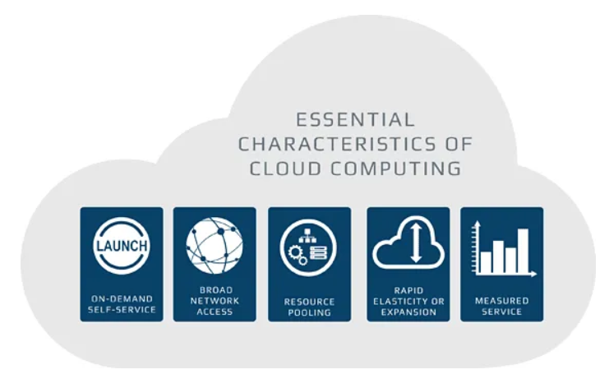
Characteristics of Cloud API
On-Demand Self-Service: Users can provision resources as needed without human intervention from the service provider.
Broad Network Access: Services are accessible over the network and can be accessed through standard mechanisms.
Resource Pooling: Computing resources are pooled to serve multiple users, with different physical and virtual resources dynamically assigned and reassigned according to demand.
Rapid Elasticity: Services can be rapidly scaled up or down to accommodate changing demand.
Measured Service: Cloud systems automatically control and optimize resource usage by leveraging metering capabilities.

Slide 11
Types Of Cloud API
Cloud APIs can be categorized based on the protocol, architecture, and functionality they support.
The four major types are:
RESTful APIs (Representational State Transfer)
SOAP APIs (Simple Object Access Protocol)
GraphQL APIs
WebSocket APIs
RESTful APIs (Representational State Transfer)
Overview:
Most widely used in modern cloud environments.
Based on HTTP protocol and stateless communication.
Uses standard HTTP methods: GET, POST, PUT, DELETE.
Key Features:
Lightweight, scalable, and fast.
Uses JSON or XML for data exchange.
Easy to integrate with web and mobile apps.
Example Use Case:
AWS S3 REST API to upload, download, or delete files from a storage bucket.

Slide 12
Types Of Cloud API [Continue….]
SOAP APIs (Simple Object Access Protocol)
Overview:
A protocol-based API that uses XML messaging.
Operates over HTTP, SMTP, TCP, or more.
Requires WSDL (Web Services Description Language) for description.
Key Features:
Supports strict contracts and standards.
Includes built-in error handling, security (WS-Security), and transaction management.
Often used in enterprise and legacy systems.
Example Use Case:
Azure Active Directory’s SOAP-based federation services.
GraphQL APIs
Overview:
Developed by Facebook as a flexible query language for APIs.
Allows clients to request only the data they need, and nothing more.
Key Features:
Ideal for complex or nested data structures.
Reduces over-fetching and under-fetching of data.
Uses a single endpoint for all queries.
Example Use Case:
GitHub uses GraphQL API to query repositories, users, and commits in a single call.

Slide 13
Types Of Cloud API [Continue….]
WebSocket APIs
Overview:
Enables real-time, full-duplex communication between client and server over a single TCP connection.
Key Features:
Persistent connection, unlike REST’s request-response model.
Efficient for chat apps, notifications, stock tickers, live dashboards.
Example Use Case:
AWS API Gateway supports WebSocket APIs for building real-time applications like multiplayer games or live IoT dashboards.
Comparison Table:
Feature | RESTful API | SOAP API | GraphQL API | WebSocket API
Protocol | HTTP | XML over HTTP/SMTP | HTTP (usually POST) | TCP (persistent)
Data Format | JSON/XML | XML | JSON | JSON, Binary
Flexibility | Medium | Low | High | High
Real-time | ❌ | ❌ | ❌ | ✅
Use Case | CRUD operations | Legacy systems, security | Complex queries | Real-time apps

Slide 14
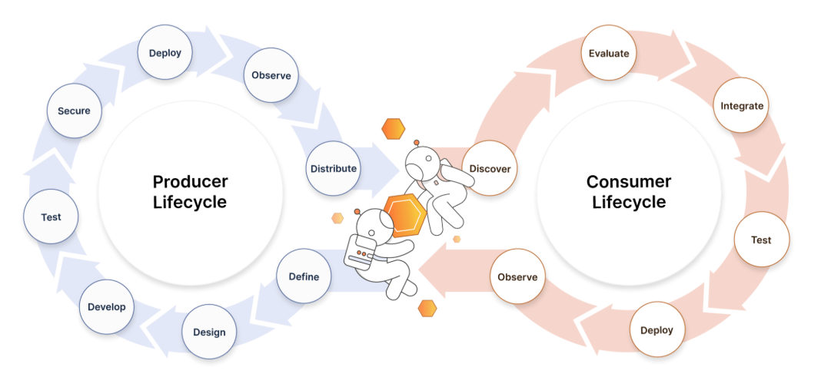
API Life Cycle Management
Planning & Design: Define endpoints, methods, security.
Development: Implement the API logic and ensure functionality.
Testing: Ensure the API behaves as expected under all conditions.
Deployment & Publishing: Host via API gateways.
Versioning: Monitor, version, and retire as needed.
Monitoring & Analytics: Track usage, performance, and security.
Retirement or Deprecation: Safely phase out APIs that are outdated or no longer used.

Slide 15
API Life Cycle Management – Requirement & Design
Objective: Define the purpose, scope, and structure of the API.
Key Activities:
Identify business requirements and consumer needs.
Define API resources, endpoints, and data models.
Choose architecture style (REST, SOAP, GraphQL).
Design URI structure, authentication, and rate limits.
Create API documentation or specification (e.g., using OpenAPI/Swagger).
Tools:
OpenAI [Swagger Hub],
Postman,
Stoplight,
Apiary

Slide 16
Requirement Phase -
Objective: Define the requirements of the API.
Functional Requirements
Accept Input:
Source_lang (e.g., "en")
target_lang (e.g., "hi")
text to translate
Returns translated text
Validate supported languages
Non-Functional Requirements
Scalability: Should handle multiple requests concurrently
Reliability: Graceful error handling if translation service fails
Security: Input sanitization, prevent misuse (e.g., abuse limit)
Performance: Fast response (<500ms for most calls)
User Roles (Optional)
Public users (anonymous)
Admin (if managing logs or limits)

Slide 17
Design Phase -
Endpoint Structure
Get/POST /translate
Request Format (JSON)
{
"source_lang": "en",
"target_lang": "hi",
"text": "Good morning"
}
Response Format
{
"translated_text": "सुप्रभात"
}
HTTP Status Codes
200 OK – Successful
400 Bad Request - Missing/invalid input
500 Internal Server Error - Downstream API failure

Slide 18
API Life Cycle Management – Development
Objective: Implement the API logic and ensure functionality.
Key Activities:
Code the API using appropriate frameworks (Flask, Express, Spring Boot).
Set up backend services, databases, and logic.
Implement authentication and authorization.
Perform unit and integration testing
Validate request/response formats.
Tools:
VS Code
Postman
Docker
render

Slide 19
API Life Cycle Management – Testing
Objective: Ensure the API behaves as expected under all conditions.
Key Activities:
Functional Testing – Correctness of API operations.
Security Testing – Prevent unauthorized access.
Load Testing – Measure performance under stress.
Regression Testing – Ensure new updates don’t break functionality
Tools:
Postman/Newman,
JMeter,
ReadyAPI,
SoapUI

Slide 20
API Life Cycle Management – Deployment & Publishing
Objective: Make the API available to consumers (internally or publicly).
Key Activities:
Deploy to cloud platforms or API gateways.
Register the API in an API Portal.
Enable API documentation, SDKs, sample requests.
Set rate limits, quotas, and caching policies.
Manage consumer access with API keys or tokens.
Tools:
AWS API Gateway
Azure API Management
Google Cloud Endpoints

Slide 21
API Life Cycle Management – Versioning
Objective: Introduce new features without breaking existing users.
Key Activities:
Implement URL-based versioning /v1 /v2.
Communicate version changes to users.
Maintain backward compatibility when possible.
Deprecate older versions gracefully.

Slide 22
API Life Cycle Management – Monitoring & Analytics
Objective: Track usage, performance, and security.
Key Activities:
Monitor request volume, latency, and error rates.
Detect unusual traffic patterns or security threats.
Generate usage reports for analytics and billing.
Trigger alerts for outages or threshold breaches.
Tools:
CloudWatch (AWS)
Azure Monitor
Prometheus + Grafana
DataDog
ELK Stack

Slide 23
API Life Cycle Management – Retirement or Deprecation
Objective: Safely phase out APIs that are outdated or no longer used.
Key Activities:
Announce end-of-life (EOL) plans to consumers.
Provide alternatives or migration guides.
Gradually disable access to the API.
Archive logs, usage data, and documentation.

Slide 24
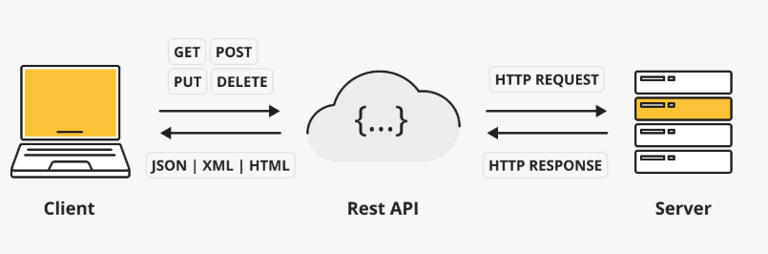
Cloud API request Methods
Cloud APIs utilize standard HTTP request methods like GET, POST, PUT, PATCH, and DELETE to interact with resources.
These methods correspond to common operations such as retrieving data, creating new data, updating data, and deleting data.
Here's a breakdown of the common HTTP methods used in Cloud APIs:
GET: Used to retrieve data from a resource.
POST: Used to create a new resource or submit data to be processed.
PUT: Used to update an entire resource or create it if it doesn't exist.
PATCH: Used to partially update a resource.
DELETE: Used to remove a resource.

Slide 25
Challenges of Cloud API
Below are the key challenges of Cloud APIs, especially from a training or implementation standpoint.
Here's a breakdown of the common HTTP methods used in Cloud APIs:
Security and Authentication.
Rate Limiting & Throttling.
Versioning and Compatibility.
Vendor Lock-In.
Monitoring and Debugging.
Latency and Performance Issues
Documentation and Usability
API Lifecycle Management
Data Consistency and Integrity
Cost Management

Slide 26
Challenges of Cloud API [Continue….]
Security and Authentication
Challenges:
Protecting APIs from unauthorized access and abuse.
Managing tokens, API keys, and role-based access control.
Risks: Data breaches, misuse of credentials, insecure endpoints.
Solutions: OAuth2.0, JWT, encryption (TLS), API gateways, WAF.
Rate Limiting & Throttling
Challenges:
APIs often have limits on the number of requests per minute/hour.
Applications may fail or slow down under high usage.
Impact: Can affect service availability or lead to request denials.
Solutions: Implement retries with exponential backoff, caching, and load balancing.

Slide 27
Challenges of Cloud API [Continue….]
Versioning and Compatibility
Challenges:
APIs evolve, but old versions may become deprecated.
Clients may break if changes are not backward compatible.
Impact: Downtime or functionality loss in client applications.
Solutions: Use versioned endpoints and proper deprecation policies.
Vendor Lock-In
Challenges:
APIs are often specific to cloud vendors (AWS, Azure, GCP).
Migrating applications between platforms can be costly and complex.
Impact: Reduced flexibility and higher long-term costs.
Solutions: Use abstraction layers or standardize on open APIs.

Slide 28
Challenges of Cloud API [Continue….]
Monitoring and Debugging
Challenges:
Hard to trace issues across distributed systems and multiple APIs.
Logs may not capture full request/response context.
Impact: Difficult to troubleshoot errors, latency, or failures.
Solutions: Use tools like API monitoring, tracing (OpenTelemetry), and centralized logging.
Latency and Performance Issues
Challenges:
Network delays, especially when APIs call external services.
Latency can accumulate in microservices-based architectures.
Impact: Poor user experience, slow applications.
Solutions: Optimize payloads, use edge computing/CDNs, caching, and async requests.

Slide 29
Challenges of Cloud API [Continue….]
Documentation and Usability
Challenges:
Poor or outdated API documentation leads to misuse and longer onboarding.
Impact: Increased development time and errors.
Solutions: Use tools like Swagger/OpenAPI for live documentation and testing.
API Lifecycle Management
Challenges:
Managing the full lifecycle: design → testing → deployment → deprecation.
Impact: Inconsistent updates, technical debt, broken integrations.
Solutions: Use API management tools (Apigee, Azure API Management, AWS API Gateway).

Slide 30
Challenges of Cloud API [Continue….]
Data Consistency and Integrity
Challenges:
Data may be eventually consistent across distributed services.
Impact: May result in stale or incorrect data views.
Solutions: Design with eventual consistency in mind, use proper synchronization mechanisms.
Cost Management
Challenges:
API usage (especially in serverless or pay-as-you-go models) can incur hidden costs.
Impact: Unexpected bills, budget overruns.
Solutions: Monitor API usage, set budget alerts, and optimize call frequency.

Slide 31
Benefits of Cloud API [Continue….]
Easy Integration
Description: Cloud APIs allow seamless connection between different services, applications, and platforms.
Example: Integrate a payment gateway (like Stripe) with a cloud-hosted e-commerce app.
Scalability
Description: Cloud APIs automatically support scale-out functionality without manual effort.
Benefit: Handle increasing workloads without redesigning infrastructure.
Automation and Efficiency
Description: APIs enable automation of repetitive tasks such as resource provisioning, monitoring, and scaling.
Example: Automate VM creation using API scripts instead of manual dashboard clicks.

Slide 32
Benefits of Cloud API [Continue….]
Cost Savings
Description: APIs can reduce operational costs by allowing efficient use of cloud resources.
How: On-demand resource provisioning reduces the need for constant human intervention.
Flexibility and Customization
Description: APIs allow developers to create custom workflows and services based on their application needs.
Example: Customize how storage is allocated or how user access is managed.
Faster Development and Deployment
Description: Developers can quickly build apps using pre-built cloud services accessible via APIs.
Benefit: Speeds up time-to-market and simplifies backend complexity.

Slide 33
Benefits of Cloud API [Continue….]
Real-Time Access to Services
Description: APIs provide real-time interaction with cloud services for data retrieval, updates, or status checks.
Example: Get real-time analytics or sensor data via cloud IoT APIs.
Standardized Communication
Description: Most Cloud APIs use standard protocols (REST, HTTP, JSON), making them easy to learn and use.
Benefit: Promotes interoperability and developer productivity.
Security and Control
Description: API gateways, tokens, and role-based access enable secure, auditable interactions.
Benefit: Only authorized users or systems can access specific resources.
Ecosystem Connectivity
Description: Easily connect with third-party services and cloud marketplaces.
Example: Link cloud applications to tools like Salesforce, Dropbox, or Slack using APIs.

